Slide 1


Capstone Project
Marketing and Retail Analytics

Slide 2
Problem Definition:
OList is one such e-commerce company that has faced some losses recently and they want to manage their inventory very well so as to reduce any unnecessary costs that they might be bearing.
you have to manage the inventory cost of this e-commerce company OList. You need to identify top products that contribute to the revenue and also use market basket analysis to analyse the purchase behaviour of individual customers to estimate with relative certainty, what items are more likely to be purchased individually or in combination with some other products.

Slide 3
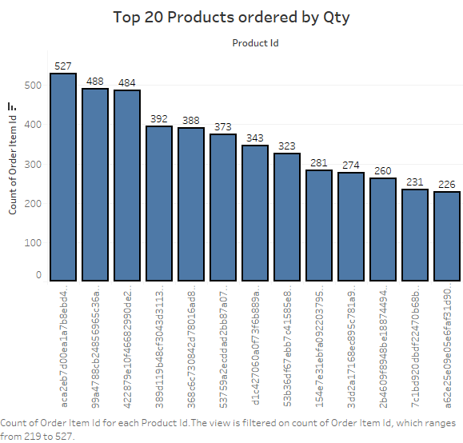
Count of order item for each product id. Colours show some of the price. The marks labelled by counts of order items.
The views is filtered on product id. Which keeps 20 of 32,951 members.

Slide 4
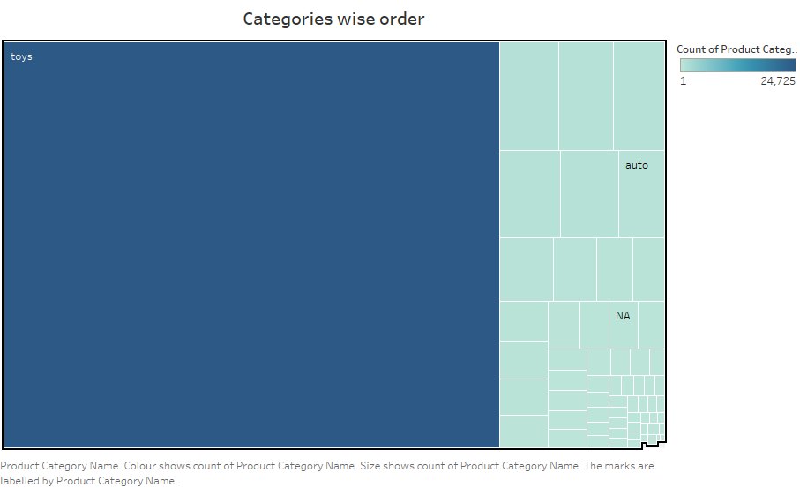
Toys has generated more revenue than any other categories

Slide 5
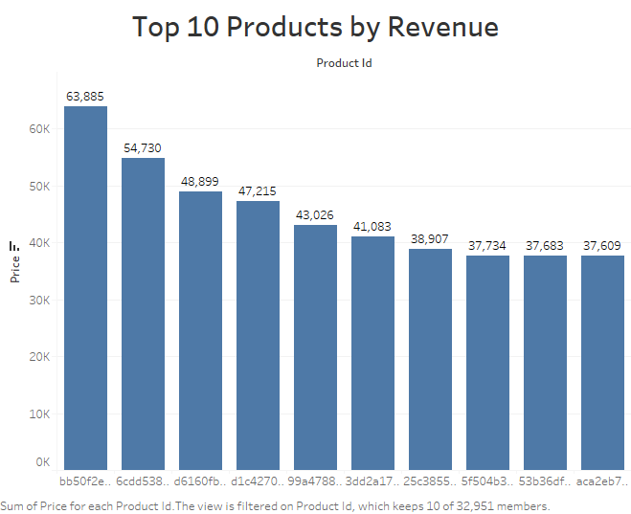
Highest Revenue Generation is 63,885 which belongs to toys category

Slide 6
Insights
The category ‘Toys’ constitutes 20% of the products which generates 80% of revenue.
It can be seen that even if the price of the certain product is high, it is still bought by the customer more often.
Toys is sold more than any other categories.

Slide 7
Recommendations
Company should focus on the customer who are not purchasing from their store by giving them offer.
As we can see the toys categories more sells happen it is purchased by their parents and family members. We can target them for other products related to small children.
Company can give more discounts to attract customers.

Slide 8
The End

